Slide 1

Project Pulse

Slide 2

P U L S E Public Utility for Localized Surveillance and Epidemiology Presented By – Data Cure Innovators

Slide 3

Business Problem
Infectious diseases pose significant challenges to healthcare organizations, including the need to monitor outbreaks, manage patient cases effectively, and allocate resources efficiently. Without a centralized system, tracking disease patterns and coordinating public health responses becomes fragmented and inefficient, leading to delayed interventions and suboptimal outcomes.

Slide 4
Business Problem Being Solved
Our system addresses this problem by tracking and managing multiple infectious diseases across different regions. It enables healthcare organizations to:
Monitor Outbreaks: Track the spread of diseases in real time and identify hotspots.
Manage Patient Cases: Maintain comprehensive patient records to streamline care and treatment.
Track Resources: Allocate medical supplies and personnel efficiently based on outbreak severity.
Analyze Disease Patterns: Generate data-driven insights for better strategic planning and public health interventions.
This solution empowers healthcare organizations to improve public health responses, mitigate outbreaks effectively, and enhance operational efficiency.

Slide 5
Main Entities in the Disease Model
Patient - Stores information such as personal details and medical history.
Disease - Captures details about diseases, including symptoms, classification, and transmission methods.
Case Record - Tracks disease cases for patients, including diagnosis, treatment, and outcomes.
Disease Test - Logs tests conducted for diseases, linking patients, healthcare providers, and facilities.
Healthcare Facility - Represents healthcare centers like hospitals and clinics where treatments and tests occur.
Resource Inventory - Maintains records of resources such as equipment and supplies available in healthcare facilities.
Healthcare Provider - Stores details about medical professionals, such as doctors and nurses, associated with healthcare facilities.
Disease Outbreak - Records information about disease outbreaks, including affected regions, start and end dates, and containment measures.

Slide 6
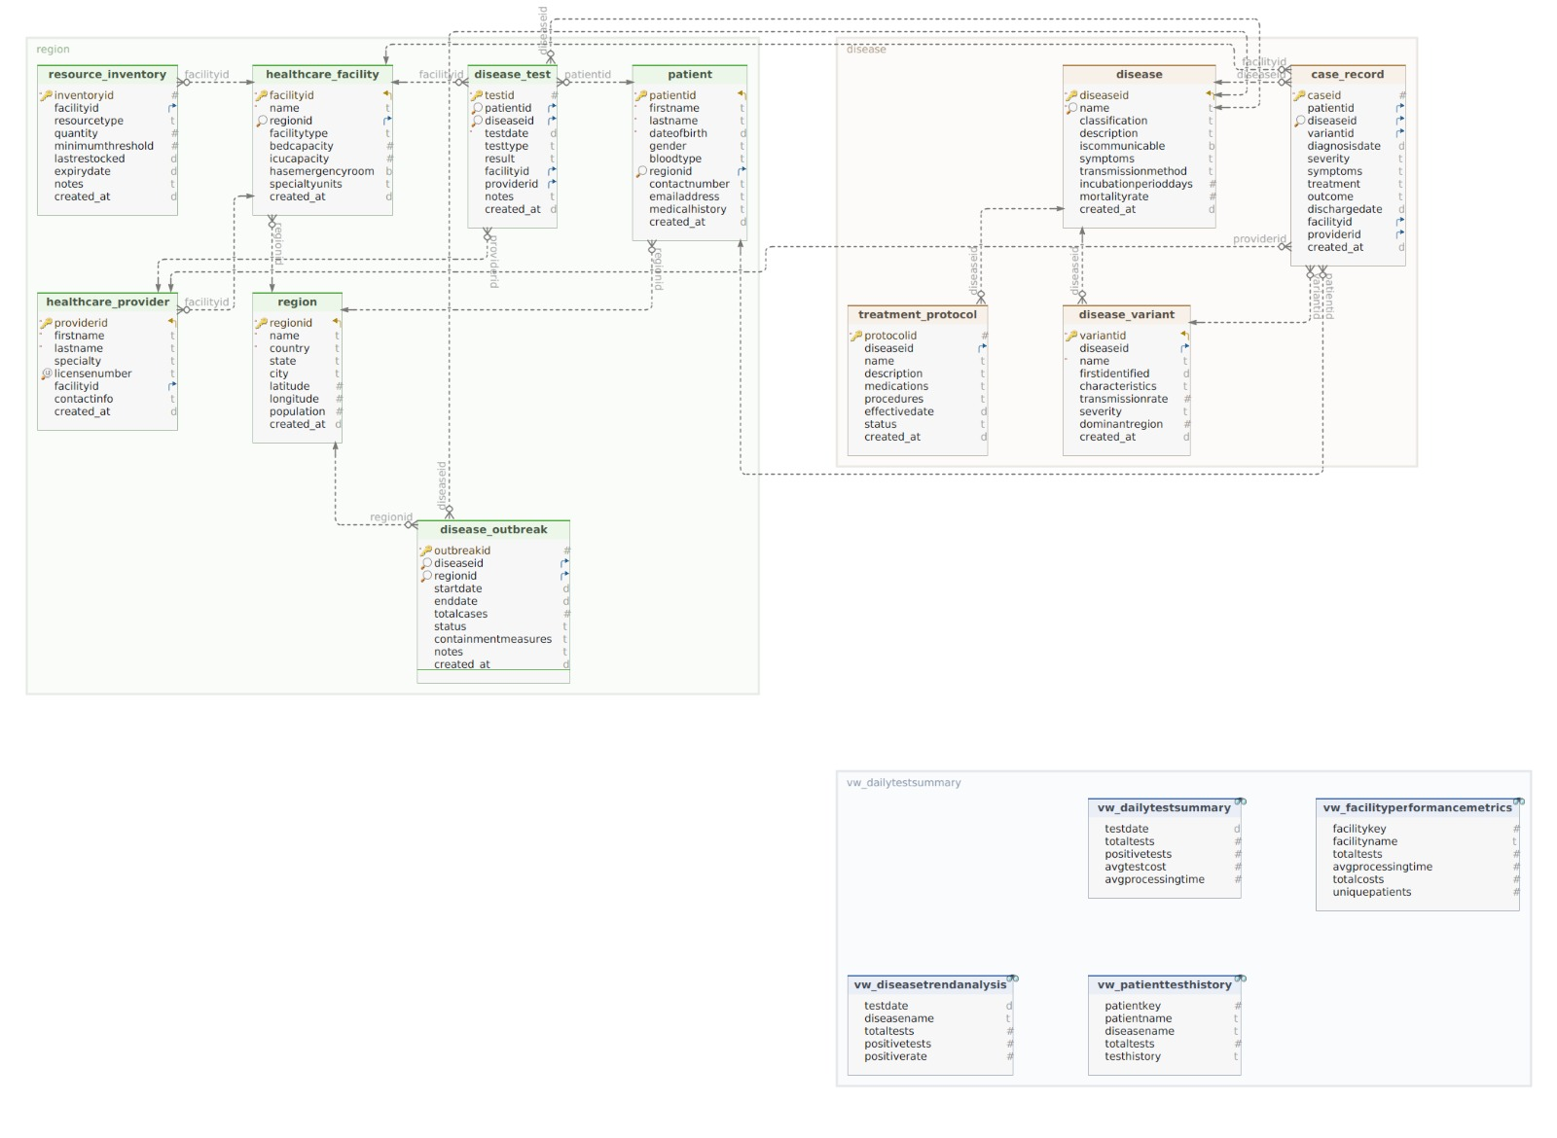
ER Diagram

Slide 7
Detailed breakdown of the 8 main entities, their attributes, primary/foreign keys, relationships, cardinality, and optionality's:
1. Patient
Attributes:
patientid (PK)
firstname
lastname
dateofbirth
gender
bloodtype
regionid (FK → region)
contactnumber
emailaddress
medicalhistory
created_at
Relationships:
Linked to region (regionid → regionid).
Linked to disease_test (patientid → patientid).
Linked to case_record (patientid → patientid).
Cardinality:
region (1) → patient (0..N): A region can have many patients.
patient (1) → disease_test (0..N): A patient can have many disease tests.
patient (1) → case_record (0..N): A patient can have multiple case records.
Optionalities:
A patient must belong to a region.
A patient may or may not have disease tests or case records.

Slide 8
2. Disease
Attributes:
diseaseid (PK)
name
classification
description
iscommunicable
symptoms
transmissionmethod
incubationperioddays
mortalityrate
created_at
Relationships:
Linked to disease_test (diseaseid → diseaseid).
Linked to case_record (diseaseid → diseaseid).
Linked to disease_variant (diseaseid → diseaseid).
Linked to disease_outbreak (diseaseid → diseaseid).
Linked to treatment_protocol (diseaseid → diseaseid).
Cardinality:
disease (1) → disease_test (0..N): A disease can have many tests.
disease (1) → case_record (0..N): A disease can appear in multiple case records.
disease (1) → disease_variant (0..N): A disease can have multiple variants.
disease (1) → disease_outbreak (0..N): A disease can cause multiple outbreaks.
disease (1) → treatment_protocol (0..N): A disease can have multiple protocols.
Optionalities:
A disease may or may not have variants, outbreaks, or protocols.

Slide 9
3.Case record
Attributes:
caseid (PK)
patientid (FK → patient)
diseaseid (FK → disease)
variantid (FK → disease_variant)
diagnosisdate
severity
symptoms
treatment
outcome
dischargedate
facilityid (FK → healthcare_facility)
providerid (FK → healthcare_provider)
created_at
Relationships:
Linked to patient, disease, disease_variant, healthcare_facility, and healthcare_provider.
Cardinality:
patient (1) → case_record (0..N): A patient can have multiple case records.
disease (1) → case_record (0..N): A disease can appear in multiple records.
disease_variant (0..1) → case_record (0..N): A variant is optional but may appear in records.
healthcare_facility (1) → case_record (0..N): A facility can manage many case records.
Optionalities:
A case must reference a patient and disease.
A disease variant is optional.

Slide 10
4.DiseaseTest
Attributes:
testid (PK)
patientid (FK → patient)
diseaseid (FK → disease)
testdate
testtype
result
facilityid (FK → healthcare_facility)
providerid (FK → healthcare_provider)
notes
created_at
Relationships:
Linked to patient, disease, healthcare_facility, and healthcare_provider.
Cardinality:
patient (1) → disease_test (0..N): A patient can have multiple tests.
disease (1) → disease_test (0..N): A disease can have multiple tests.
Optionalities:
A test must reference a patient and disease.

Slide 11
5.Healthcare facility
Attributes:
facilityid (PK)
name
regionid (FK → region)
facilitytype
bedcapacity
icucapacity
hasemergencyroom
specialtyunits
created_at
Relationships:
Linked to region, resource_inventory, healthcare_provider, case_record, and disease_test.
Cardinality:
region (1) → healthcare_facility (0..N): A region can have multiple facilities.

Slide 12
6.Resource inventory
Attributes:
inventoryid (PK)
facilityid (FK → healthcare_facility)
resourcetype
quantity
minimumthreshold
lastrestocked
expiredate
notes
created_at
Relationships:
Linked to healthcare_facility.
Cardinality:
healthcare_facility (1) → resource_inventory (0..N): A facility can have multiple resources.

Slide 13
7.Healthcare provider
Attributes:
providerid (PK)
firstname
lastname
specialty
licensenumber
facilityid (FK → healthcare_facility)
contactinfo
created_at
Relationships:
Linked to healthcare_facility, disease_test, and case_record.
Cardinality:
healthcare_facility (1) → healthcare_provider (0..N): A facility can have multiple providers.

Slide 14
8. Disease Outbreak
Attributes:
outbreakid (PK)
diseaseid (FK → disease)
regionid (FK → region)
startdate
enddate
totalcases
status
containmentmeasures
notes
created_at
Relationships:
Linked to disease and region.
Cardinality:
disease (1) → disease_outbreak (0..N): A disease can cause multiple outbreaks.
region (1) → disease_outbreak (0..N): A region can experience multiple outbreaks.

Slide 15
Creating and Populating the OLTP Database
The purpose of this step is to implement a fully functional Online Transaction Processing (OLTP) database for healthcare management using PostgreSQL. The OLTP database is designed to handle daily operational tasks, such as tracking patient cases, managing healthcare facilities, and monitoring disease outbreaks, while ensuring fast and efficient querying of transactional data.

Slide 16
Data Population
Each table was populated to simulate real-world healthcare operations.
Data includes:
Regions: Geographic locations where healthcare facilities operate.
Healthcare Facilities: Details about hospitals and clinics, including ICU capacity and emergency capabilities.
Patients: Personal details and medical histories of individuals.
Diseases: Information about various diseases, including symptoms, classifications, and communicability.
Case Records: Detailed tracking of disease diagnoses, treatments, and outcomes for patients.
Disease Tests: Logs of diagnostic tests conducted for patients.
Healthcare Providers: Information about doctors and specialists working in healthcare facilities.
Resource Inventory: Details about available medical resources, such as ventilators, PPE kits, and medicines.

Slide 17
Query 1: List all patients with severe diseases Question: How can we identify patients suffering from severe diseases, along with their symptoms, treatments, and the healthcare facilities managing their care?
SELECT
p.firstname || ' ' || p.lastname AS patient_name,
d.name AS disease_name,
c.severity,
c.symptoms,
c.treatment,
h.name AS healthcare_facility
FROM
case_record c
JOIN
patient p ON c.patientid = p.patientid
JOIN
disease d ON c.diseaseid = d.diseaseid
JOIN
healthcare_facility h ON c.facilityid = h.facilityid
WHERE
c.severity = 'Severe';

Slide 18
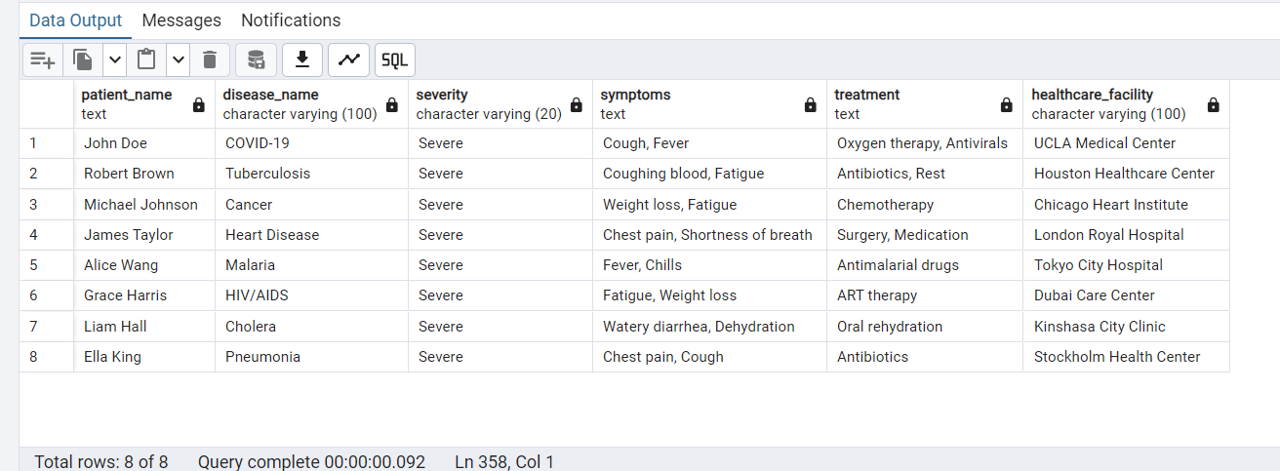
Output

Slide 19
Query 2: Find facilities with the highest ICU capacity Question: Which healthcare facilities have the highest ICU capacities, and how do they rank?
SELECT
h.name AS healthcare_facility,
h.icucapacity
FROM
healthcare_facility h
ORDER BY
h.icucapacity DESC
LIMIT 5;

Slide 20
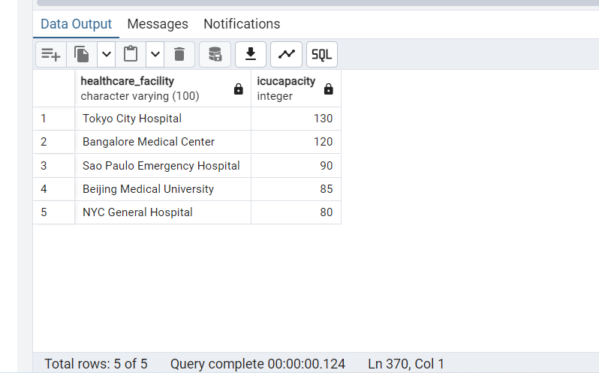
Output

Slide 21
Query 3: Identify healthcare providers handling critical cases Question: Which healthcare providers are handling the most critical cases and which facilities do they belong to?
SELECT
hp.firstname || ' ' || hp.lastname AS provider_name,
h.name AS healthcare_facility,
COUNT(c.caseid) AS critical_cases
FROM
case_record c
JOIN
healthcare_provider hp ON c.facilityid = hp.facilityid
JOIN
healthcare_facility h ON hp.facilityid = h.facilityid
WHERE
c.severity IN ('Severe', 'Critical')
GROUP BY
hp.providerid, hp.firstname, hp.lastname, h.name
ORDER BY
critical_cases DESC;

Slide 22
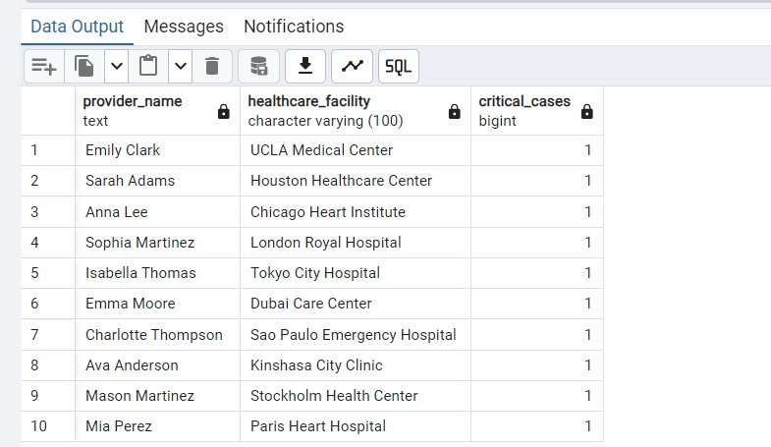
Output

Slide 23
Dimensional Database
Grain:
The Patient-Test-Date Level is the finest level of granularity in a healthcare data warehouse. Each record in the fact table represents a single test conducted for a patient on a specific date. This grain ensures that every test, even multiple tests for the same patient on the same date, is recorded as a distinct entry.
Why Use the Patient-Test-Date Grain?
Detailed Patient Tracking: This level captures every individual test, enabling detailed tracking of patient histories, treatments, and test outcomes.
Disease Progression Monitoring: By keeping test data at this level, analysts can study disease progression patterns and treatment effectiveness over time.

Slide 24
Dimension Tables
DimDate –
Stores all possible dates for analysis
Enables time-based analysis (by year, quarter, month, week)
Helps track seasonal patterns in disease outbreaks
Allows weekend vs. weekday comparisons for hospital activity

Slide 25
Dimension Tables
DimPatient –
Stores patient demographics and classifications
Tracks changes in patient risk categories over time
Enables analysis by age groups and risk factors
Helps identify vulnerable populations
Includes SCD Type 2 tracking (StartDate, EndDate, IsCurrent)

Slide 26
Dimension Tables
DimDisease –
Contains disease and variant information
Tracks changes in disease classifications
Enables analysis by disease type and communicability
Monitors variant evolution and severity
Includes historical tracking of disease definitions

Slide 27
Dimension Tables
DimLocation –
Stores geographic hierarchy (Country → State → City)
Includes population and density metrics
Enables geographic analysis of disease spread
Helps identify high-risk areas
Tracks changes in regional demographics

Slide 28
Dimension Tables
DimProvider –
Stores healthcare provider information
Tracks provider specialties and experience
Enables analysis of provider performance
Monitors provider availability and workload
Maintains historical provider assignments

Slide 29
Dimension Tables
DimFacility –
Contains healthcare facility information
Tracks facility capabilities and capacity
Enables resource allocation analysis
Monitors emergency response capabilities
Tracks changes in facility status

Slide 30
Dimension Tables
Each dimension table includes:-
Natural keys (IDs from source system)
Business attributes for analysis
Historical tracking capabilities
Current status indicators
Relevant metrics for analysis

Slide 31
Fact Tables
FactCases – Records individual patient disease cases
Measures:
Severity of cases
Length of stay in facilities
Treatment outcomes
Treatment costs
Business Use:
Track treatment effectiveness
Monitor healthcare costs
Analyze patient outcomes
Measure facility performance

Slide 32
Fact Tables
FactTests - Tracks all disease testing activities
Measures:
Test results
Test types
Testing costs
Business Use:
Monitor testing patterns
Track positivity rates
Analyze testing costs
Measure testing efficiency

Slide 33
Fact Tables
FactOutbreaks - Monitors disease outbreak events
Measures:
Total cases in outbreak
Mortality rates
Economic impact
Duration (start/end dates)
Business Use:
Track outbreak patterns
Assess economic impact
Monitor containment effectiveness
Predict future outbreaks

Slide 34
Fact Tables
FactInventory - Tracks medical resource inventory
Measures:
Resource quantities
Resource values
Days of supply
Resource types
Business Use:
Monitor resource utilization
Track supply levels
Optimize resource distribution
Prevent stockouts

Slide 35
Key Analysis Capabilities:
Cost Analysis
Resource Utilization
Disease Spread Patterns
Healthcare Outcomes
Facility Performance
Provider Effectiveness

Slide 36
Comparison Between NO SQL and RELATIONAL Databases
Relational/Current Database Structure
The schema represents a relational database model with clearly defined tables, primary keys, foreign keys, and relationships. Each table corresponds to a specific entity in the domain (e.g., patient, disease, region, healthcare_facility) and contains attributes relevant to that entity.
Key Characteristics:
Normalization: Data is normalized across multiple tables to eliminate redundancy. For example, disease details are stored in the disease table, while its variants are in a separate disease_variant table.
Relationships: Tables are linked through foreign keys. For instance, case_record links to patient, disease, and healthcare_facility.
Indexes: Indexed columns (e.g., idx_test_patient) enhance query performance.
Joins: Retrieving complex data typically involves joining multiple tables using relationships.

Slide 37
Comparison Between NO SQL and RELATIONAL Databases
NoSQL Database Structure
In a NoSQL database (e.g., MongoDB, Couchbase), the schema would be more flexible and could be structured using documents or collections. The data model would likely use a denormalized approach to improve performance for certain queries and avoid joins.
Key Characteristics:
Collections and Documents: Each entity could be a collection, and related data might be embedded within documents instead of using separate tables.
Example: case_record might embed patient and disease data directly within the document.
Schema Flexibility: Fields can vary between documents within a collection, allowing dynamic schema adjustments.
Denormalization: Related data (e.g., disease and its variants) could be stored together in a single document to reduce lookup times.
Scalability: Horizontal scaling is easier, as documents are distributed across clusters.

Slide 38
Comparison Between NO SQL and RELATIONAL Databases
Feature | Relational | NoSQL
Structure | Fixed schema with tables and relationships. | Flexible schema with collections and documents.
Normalization | High normalization, avoids data redundancy. | Denormalization for performance.
Joins | Requires joins for related data. | Embeds related data to avoid joins.
Query Language | SQL (structured queries). | NoSQL (e.g., MongoDB Query Language, JSON-like).
Scalability | Vertical scaling (limited horizontal scaling). | Easy horizontal scaling via sharding.
Flexibility | Schema is rigid; changes can be costly. | Schema is flexible; supports dynamic fields.
Performance | Slower for complex queries due to joins. | Faster for read-heavy operations (denormalized).
Use Case | Best for complex transactions and data integrity. | Best for unstructured or semi-structured data.

Slide 39
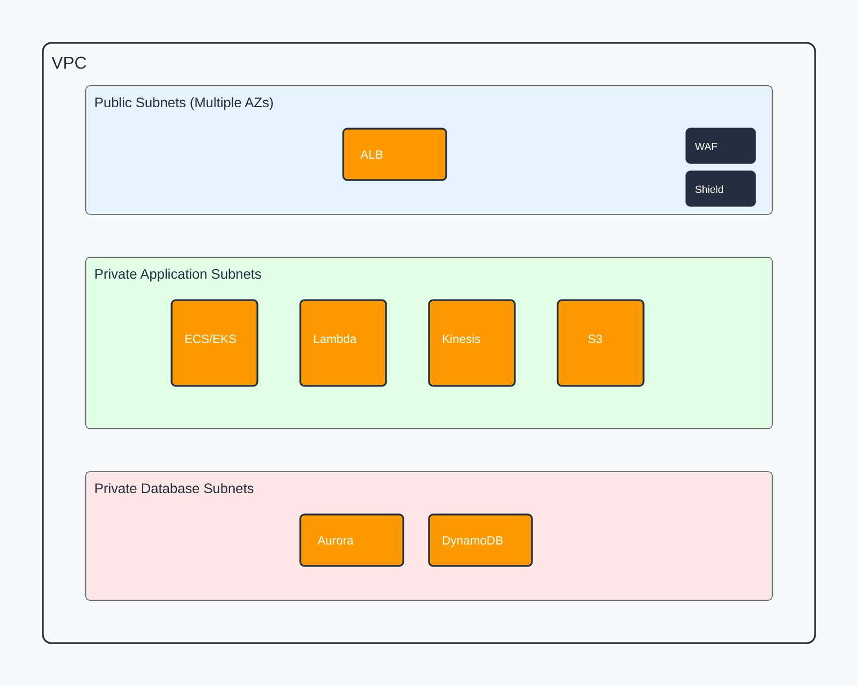
AWS Architecture

Slide 40
AWS Architecture
Core Infrastructure:-
Multi-AZ VPC with public/private subnets
Application Load Balancer (ALB) for traffic distribution
ECS/EKS clusters for containerized applications
Lambda functions for serverless processing
Data Processing (Lambda Architecture):
Batch Layer -
S3 → Glue ETL → EMR → Aurora
Speed Layer -
Kinesis → Lambda → DynamoDB
Serving Layer -
Aurora (relational) + DynamoDB (NoSQL)
ElastiCache for performance

Slide 41
AWS Architecture
Security:-
Multi-layer security (WAF, Shield, VPC)
Encryption at rest and in transit
IAM roles and AWS Secrets Manager
High Availability:-
Multi-AZ deployments
Auto-scaling groups
Cross-region replication
Disaster recovery strategy

Slide 42
AWS Architecture
Performance Optimization:-
Aurora read replicas
DynamoDB DAX
ElastiCache
CloudFront CDN
Monitoring:-
CloudWatch metrics
X-Ray tracing
Centralized loggingKey

Slide 43
AWS Architecture
Benefits:
✓ Scalable
✓ Highly available
✓ Secure
✓ Cost-efficient
✓ Compliant
✓ Real-time & batch processing capable

Slide 44
Snowflake Integration Benefits for Disease Tracking System
Key Advantages:-
Single platform for structured (patient data) & semi-structured (medical notes) data
Automatic scaling for outbreak scenarios
Pay-per-second pricing with storage/compute separation
Zero-copy cloning for testing environments
Time travel feature for historical analysis

Slide 45
Snowflake Integration Benefits for Disease Tracking System
Healthcare-Specific Benefits:-
HIPAA compliance & robust security features
Secure data sharing with partners
Real-time outbreak monitoring capabilities
Geospatial analysis for disease spread tracking
Seamless AWS integration via Snowpipe

Slide 46
Snowflake Integration Benefits for Disease Tracking System
Cost & Performance Impact:
✓ Reduced operational overhead
✓ Improved complex query performance
✓ Better resource utilization
✓ Simplified data warehouse architecture
✓ Enhanced analytical capabilities

Slide 47
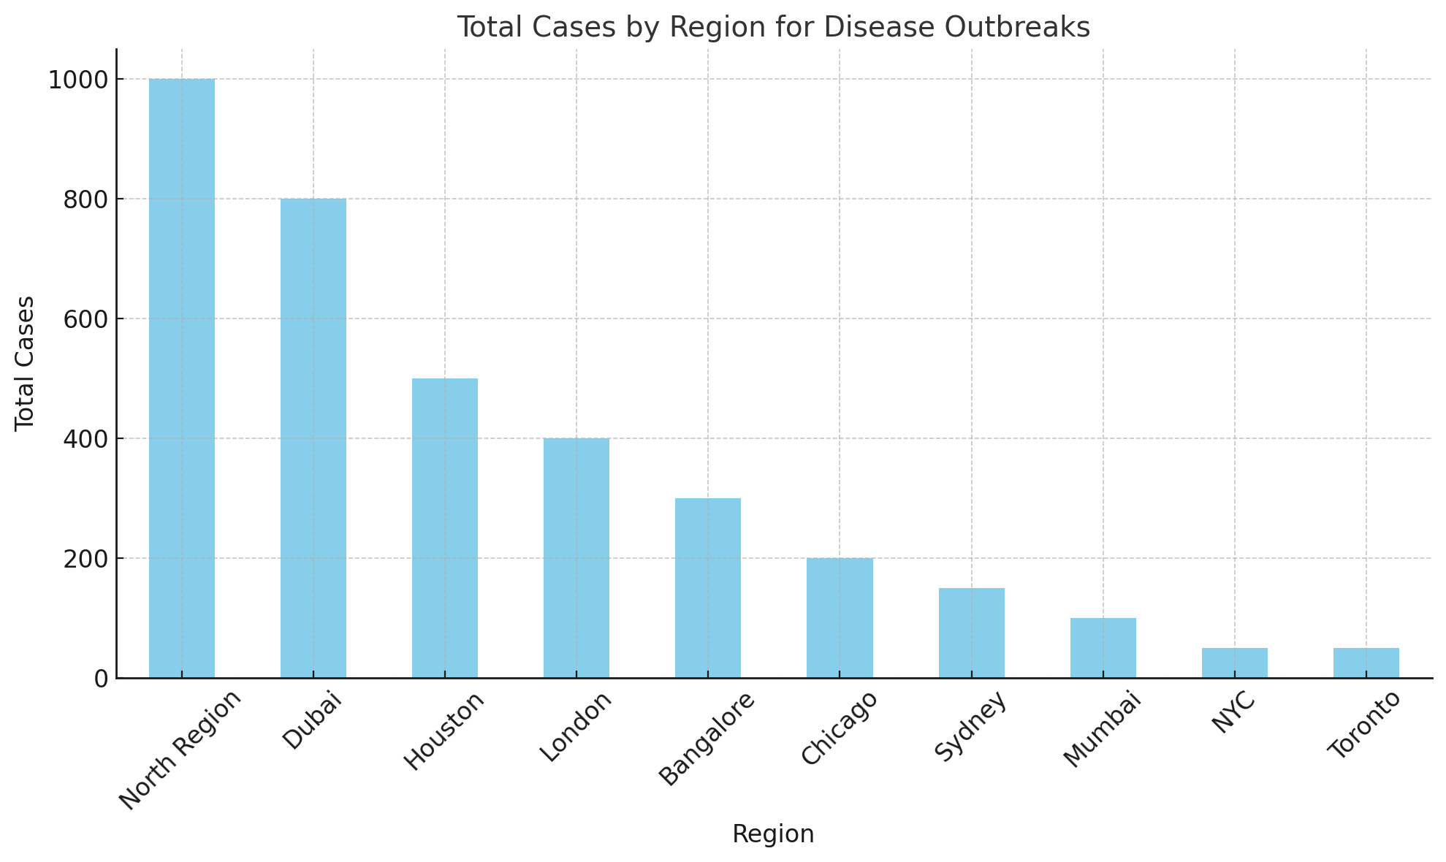
Disease Outbreak Analysis:
Total Cases by Region for Disease Outbreaks: A bar chart shows the total number of cases by region, highlighting high-risk areas such as "North Region" and "Dubai" with significant outbreaks.

Slide 48
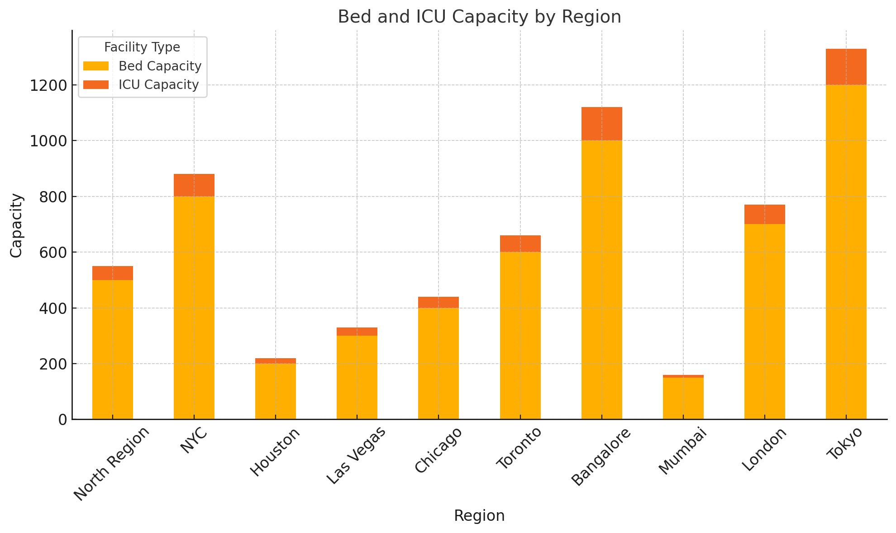
Healthcare Facility Utilization
Bed and ICU Capacity by Region: A stacked bar chart compares bed and ICU capacities across regions, showing resource distribution and regions with higher healthcare facility capacity.

Slide 49
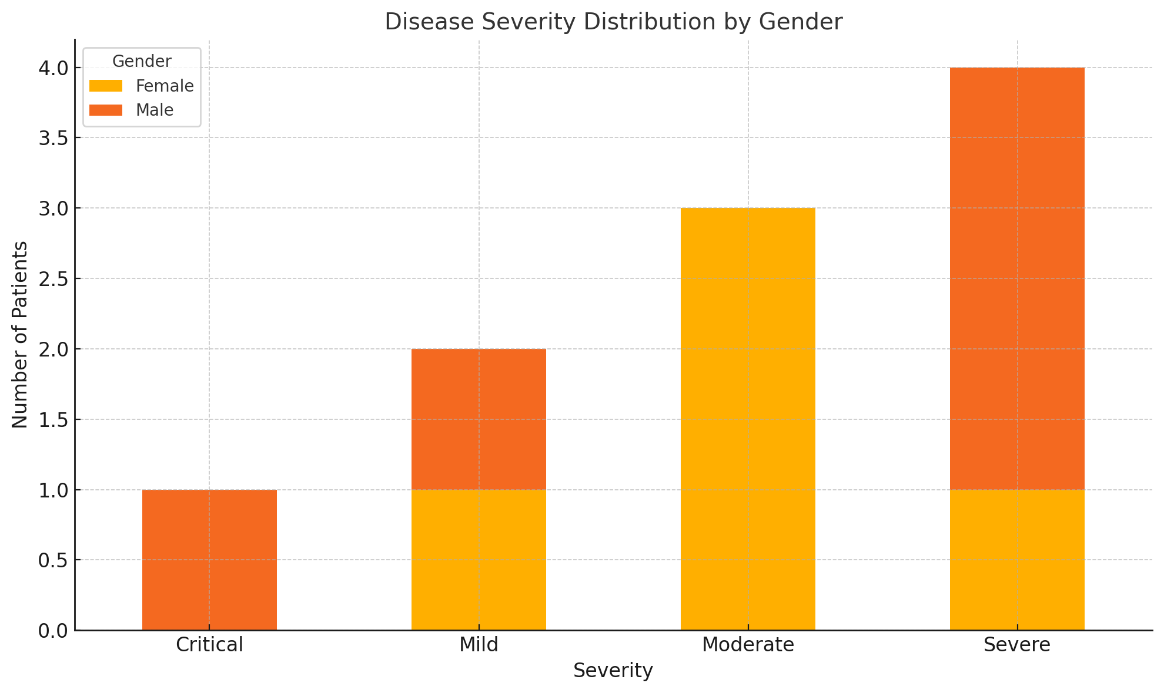
Patient Disease Severity By Gender:
Disease Severity Distribution by Gender: A stacked bar chart illustrates the distribution of disease severity (e.g., severe, moderate) by gender, providing demographic insights into health impacts.

Slide 50
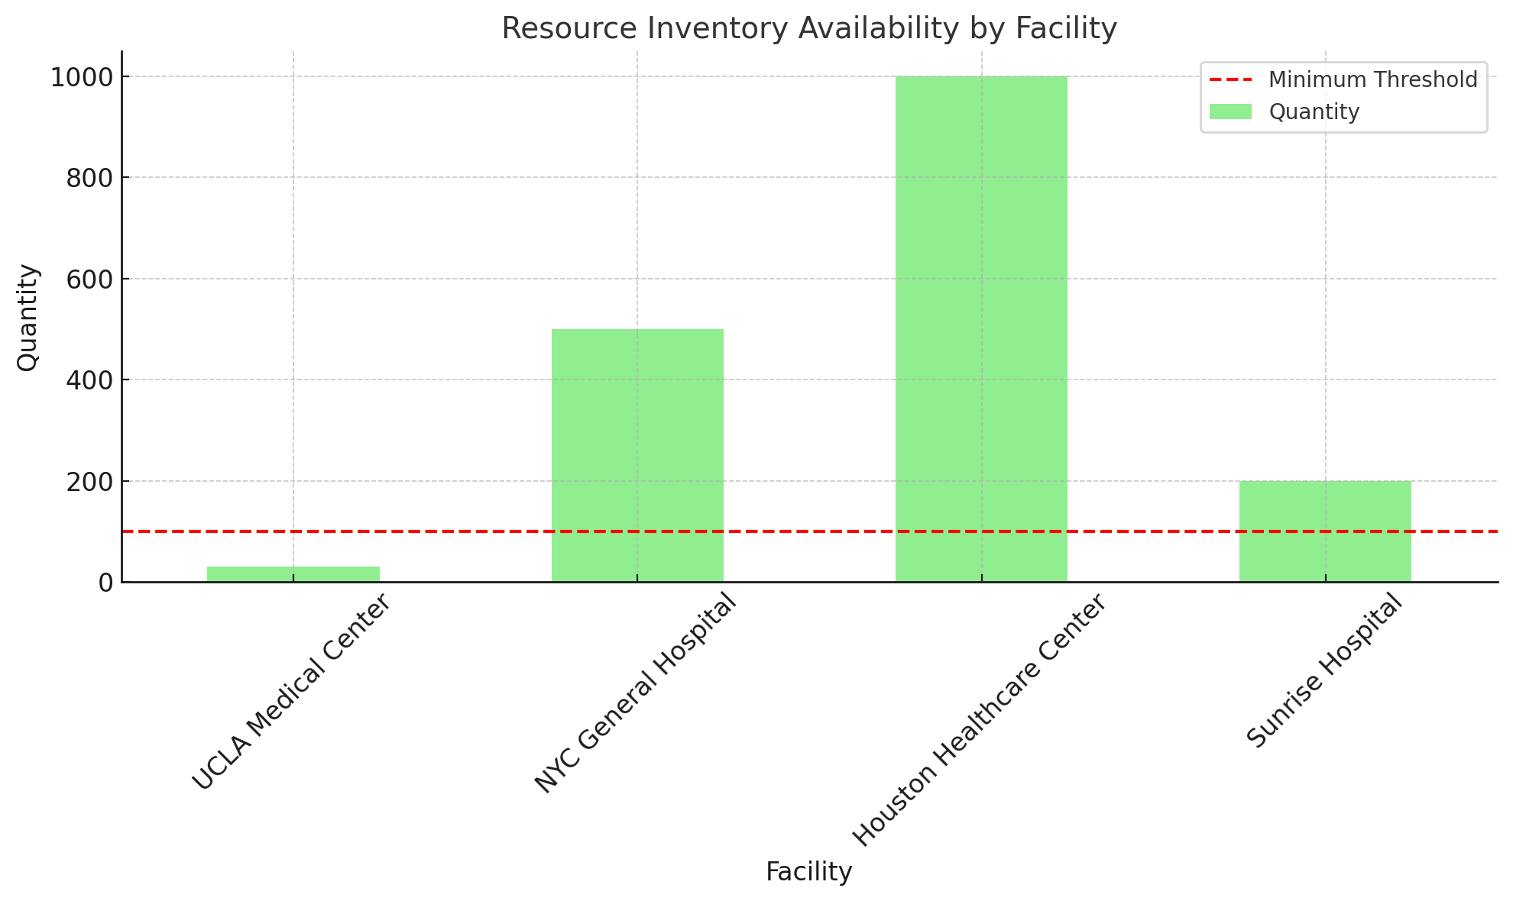
Resource Inventory:
Resource Inventory Availability by Facility: A bar chart displays the availability of critical resources like ventilators and insulin in facilities, with a threshold line indicating critical minimum levels.

Slide 51

Thank You

